Slide 1

Analysis of Coca-Cola Stock
Luz Melo | Gia Smith | Meesun Yang
DS 7200 Distributed Computing, Fall 2023
12/5/2023

Slide 2

Table of Contents
Executive Summary
Data Summary & Exploration
Variable Transformations and Preprocessing
Models Constructed
Model Performance
Conclusions and Future Research

Slide 3
Executive Summary
Research Question:
How well can we predict Coca-Cola stock price movement using historical stock price data and/or historical earnings financial data?
Findings:
Linear model is not good
SVM is the champion!
Historical stock price data alone do not provide the best predictors for predicting stock movement

Slide 4
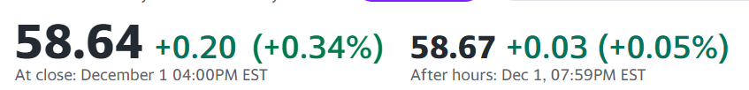
Data Summary
The Coca-Cola Company (KO)
NYSE - NYSE Delayed Price. Currency in USD
Data Source: Yahoo Finance
Daily historical stock price: 15,578 samples in one dataset
Quarterly earnings financial data: 139 samples across 4 datasets
Target Variables:
Rate of return
Adjusted close
Predictors:
Open, Close, High, Low, Volume from previous days (historical stock data)
See Appendix I for a subset of quarterly earnings financial predictors

Slide 5
Variable Transformations and Preprocessing
Preprocessing Steps:
Daily historical data (5 predictors):
Generate Rate of Return data and add to dataframe
Generate D statistic and add to dataframe
Remove rows with null values
Quarterly earnings financial data (106 predictors):
Combine all CSV files into one dataframe
Remove rows and columns with null values
Align all data using uniform dates
Data scaling
Data splitting: 80/20 test/train split
Notes:
Data Normalization Due to the inconsistency in the used data and to avoid the classifier from been biased towards larger values, the selected data were normalized to the range of 0 and 1. This was done to improve the performance of the models during testing.

Slide 6
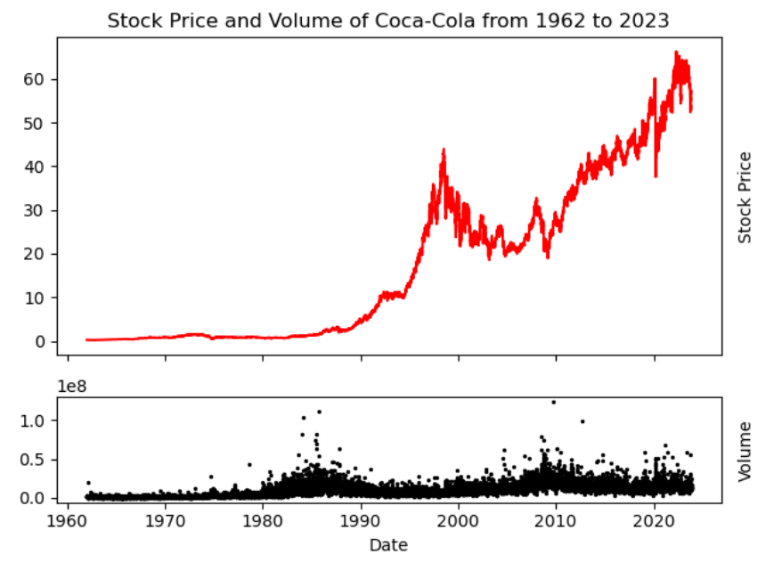
Data Exploration
The Coca-Cola Company (KO)
NYSE - NYSE Delayed Price. Currency in USD
Exploratory data analysis using PySpark:
The average closing price: 17.45
On 2022-04-21, the stock price was the highest: 63.32
Minimum volume: 77 thousand on
1963-10-16
Maximum volume: 124 million on
2009-09-18

Slide 7
Models Constructed
Linear Regression
Support Vector Machines (SVM)
Naïve Bayes
Gradient-boosted Trees
Random Forest (Decision Trees)

Slide 8
Model Performance: Linear Regression
Target | Adjusted Close |  | Rate of Return
 | MSE | R-Squared | MSE | R-Squared
Daily Stock Price Data | 14.21 | 0.94 | 0.00 | 0.00
Quarterly Earnings Data | 16.62 | 0.95 | 0.00 | 0.00

Slide 9

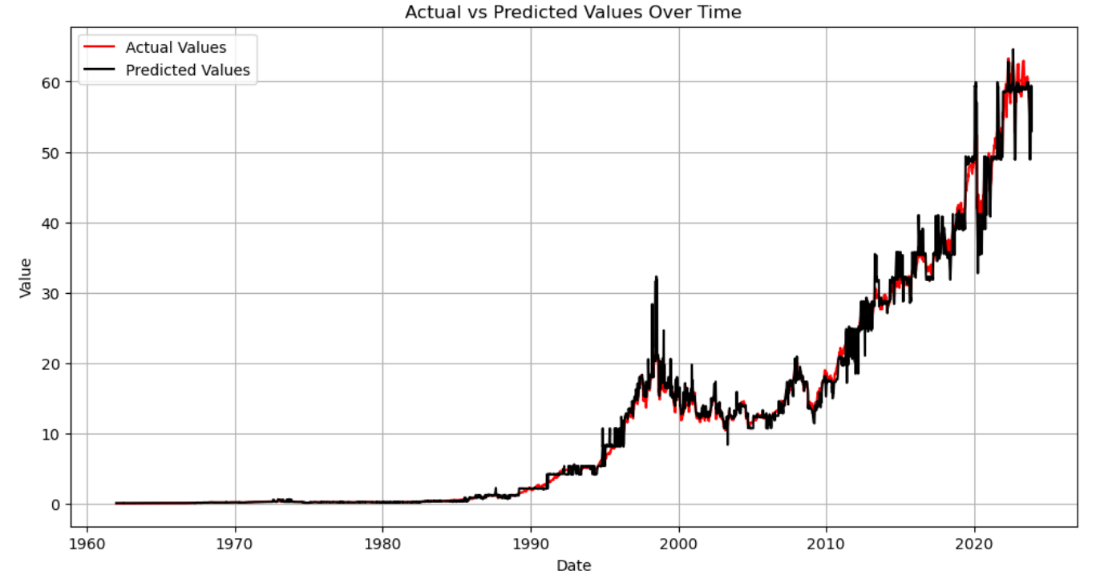
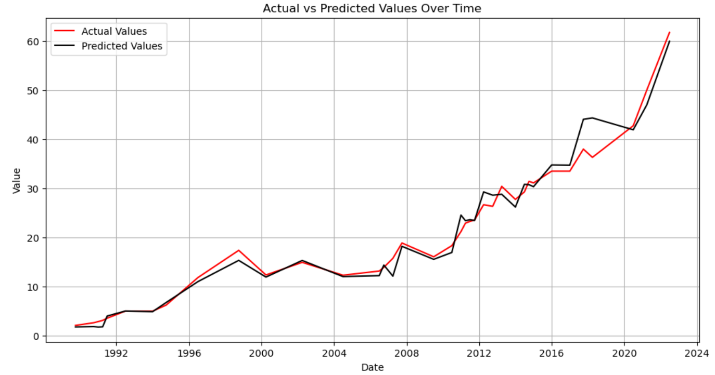
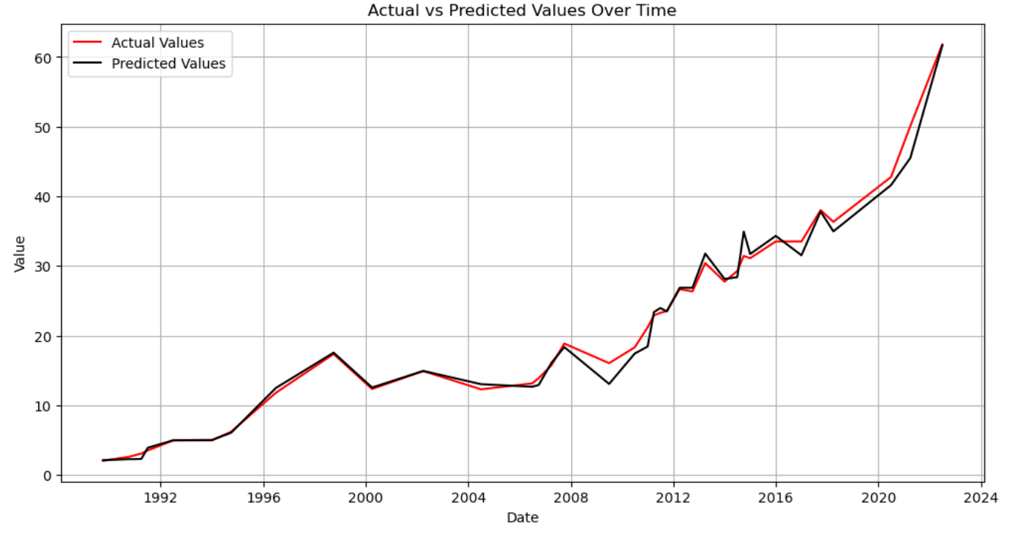
Model Performance: Gradient-boosted Trees
Experiment: Can more features compensate for less data?
Stock price prediction: Daily data
Features: open, high, low, close, volume
Stock price prediction: Quarterly data
Features: open, high, low, volume
Stock price prediction: Quarterly data
Features: open, high, low, volume, … 100 more!
MAE: 0.61
RMSE: 1.21
R-Squared: 0.99
MAE: 0.86
RMSE: 1.34
R-Squared: 0.99
MAE: 1.45
RMSE: 2.18
R-Squared: 0.97

Slide 10
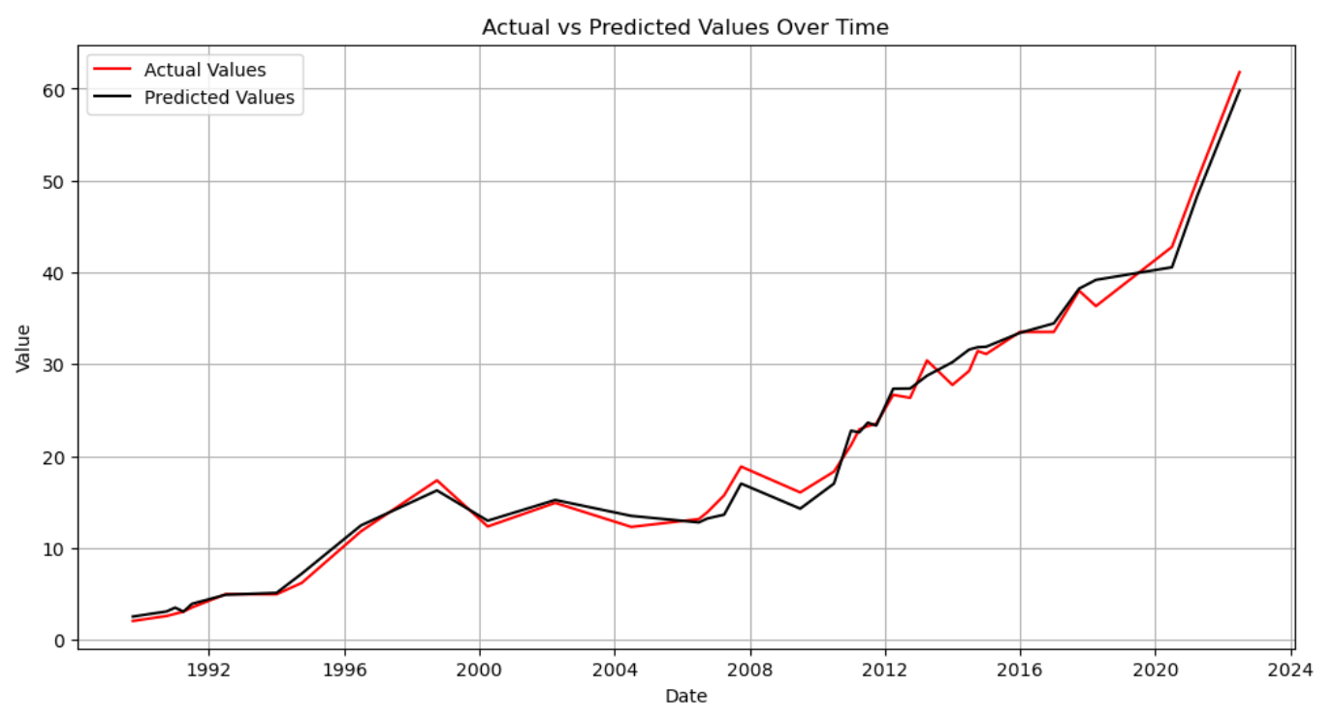
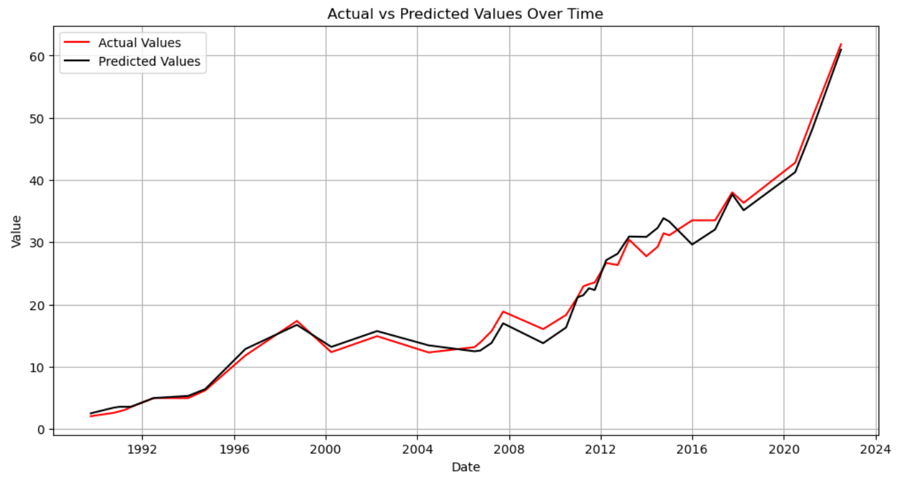
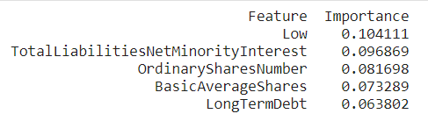
Model Performance: Random Forest
Experiment: Does feature extraction improves the performance?
Stock price prediction: Quarterly data
Features: open, high, low, volume, … 100 more!
Stock price prediction: Quarterly data
Features: top 5 features
MAE: 1.00
RMSE: 1.27
R-Squared: 0.99
MAE: 1.12
RMSE: 1.51
R-Squared: 0.98

Slide 11
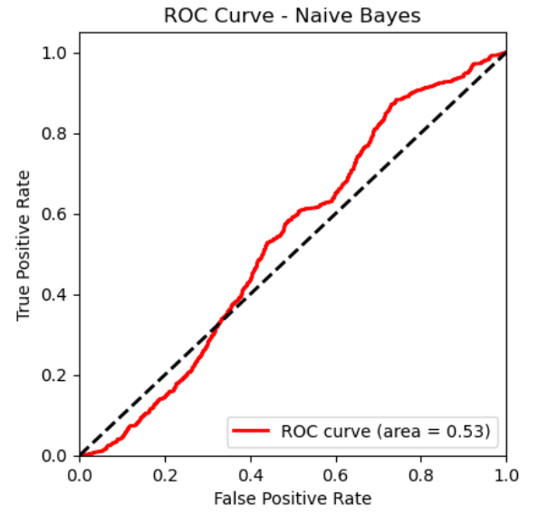
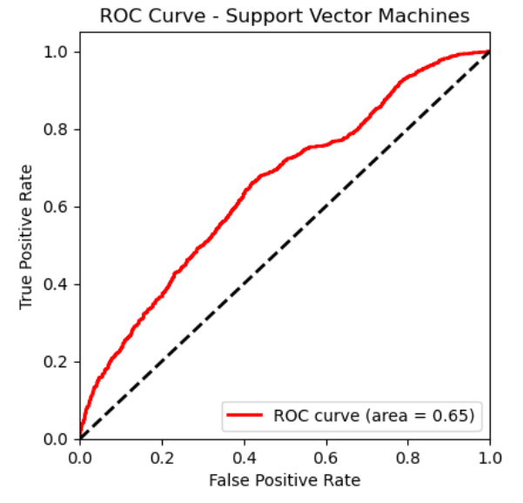
Model Performance: Naive Bayes and SVM

Slide 12
Conclusions and Future Research
Conclusions:
The champion model is SVM.
Historical stock price data alone may not be the best predictors.
Future Research:
Verify our model results against actual future stock movement
Utilize other financials/features for predictors (that we were not able to collect here)
Create additional models with other stocks

Slide 13
Appendix I
Subset of Predictors from Quarterly Earnings Reports:
"PeRatio", "PsRatio", "PbRatio","TotalRevenue","GrossProfit", "EnterprisesValueRevenueRatio", "EnterprisesValueEBITDARatio", "OperatingExpense", "OperatingIncome", "NetIncome", "BasicEPS", "TotalExpenses", "NormalizedIncome", "EBIT", "EBITDA", "TotalAssets", "CashAndCashEquivalents", "NetPPE", "GrossPPE", "TotalDebt", "RetainedEarnings"

Slide 14
THANK YOU!

